Slide 1


Slide 2
Problem Statements:
Solutions required to solve the challenges faced by Law Investigating Officers (LEOs) in Cyber Crimes:
1) Mechanism / tool that retrieves the information relating to transmission of a disputed posting and immediate deletion of the same within no time from WhatsApp messenger.
2) Mechanism / tool that capture the GPS coordinates & other credentials of certain message / posting posted using WhatsApp / Facebook and other messaging APPs.
3) Mechanism / tool that retrieves the initial user of certain posting in WhatsApp and Facebook using message ID.
4) Mechanism / tool that pings any social media account and capture the IP address and other credentials associated with that account.
5) Mechanism / tool / device that sends a signal to the target mobile and calculate the distance and direction from the source.

Slide 3
Proposed Idea and Architecture

Slide 4
Social Media App
GPS Access Primary Requirement
Admin Panel
User Interface
Reported Messages
Blocked Messages
Capture IP & GPS Coordinates
Sender & Initial Sender
Sender Side
Message
Sentiment Analysis + Keyword Matching
IP & Credential
Location Tracking
Disputed
Non-Disputed
After Certain Count
Keyword is added
Message Blocked
Positive
Negative
Keyword Extraction
Message sent to Receiver

Slide 5


Challenges Faced
Data protection
End-to-End Encryption
User’s Privacy

Slide 6
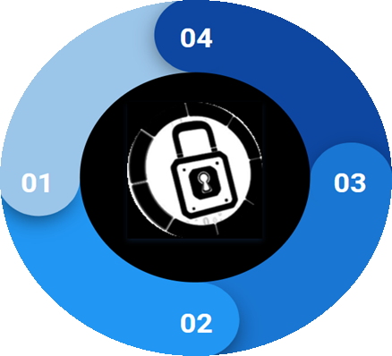
How we Overcome those Difficulties
TF Lite Model
No Message Content is shared with External server
Predictions made
Locally
End-to-End privacy is
maintained

Slide 7

Advantages of TF Lite Model:
Require very less space
Gives Faster Result
Predictions made locally
No Compromise with user’s privacy, Data Protection and End-to-End Encryption
Can be used in Production without any Reluctance
Model Size | Device | CPU
0.6Mb | Pixel 3 (Android 10) | 0.05ms*
 | Pixel 4 (Android 10) | 0.05ms*
 | iPhone XS (iSO 12.4.1) | 0.025ms**
Source: https://www.tensorflow.org/lite/models/text_classification/overview

Slide 8
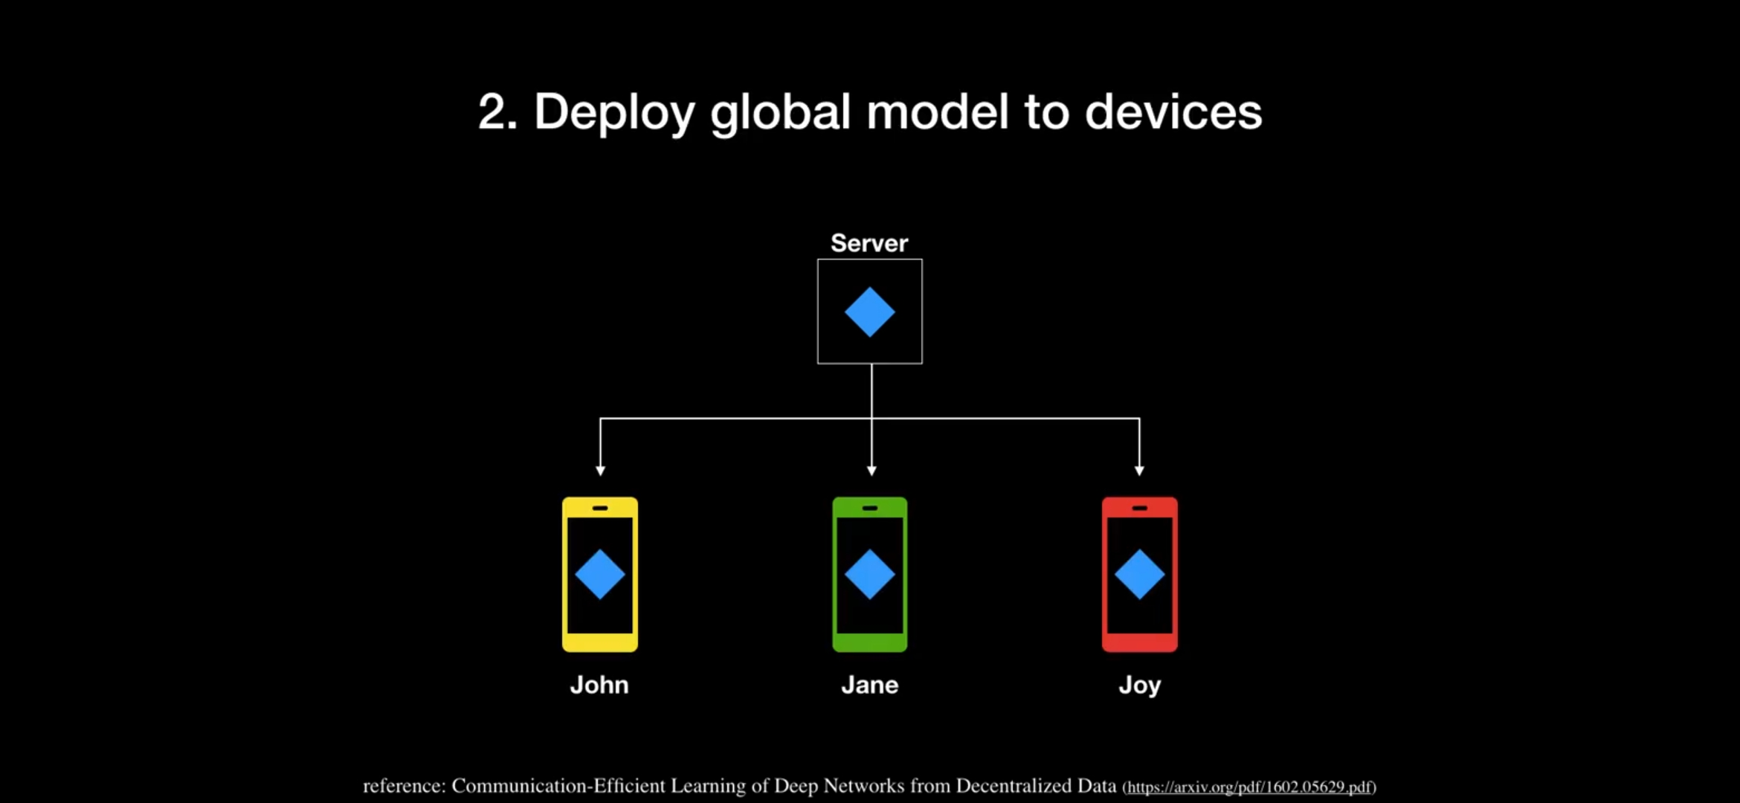
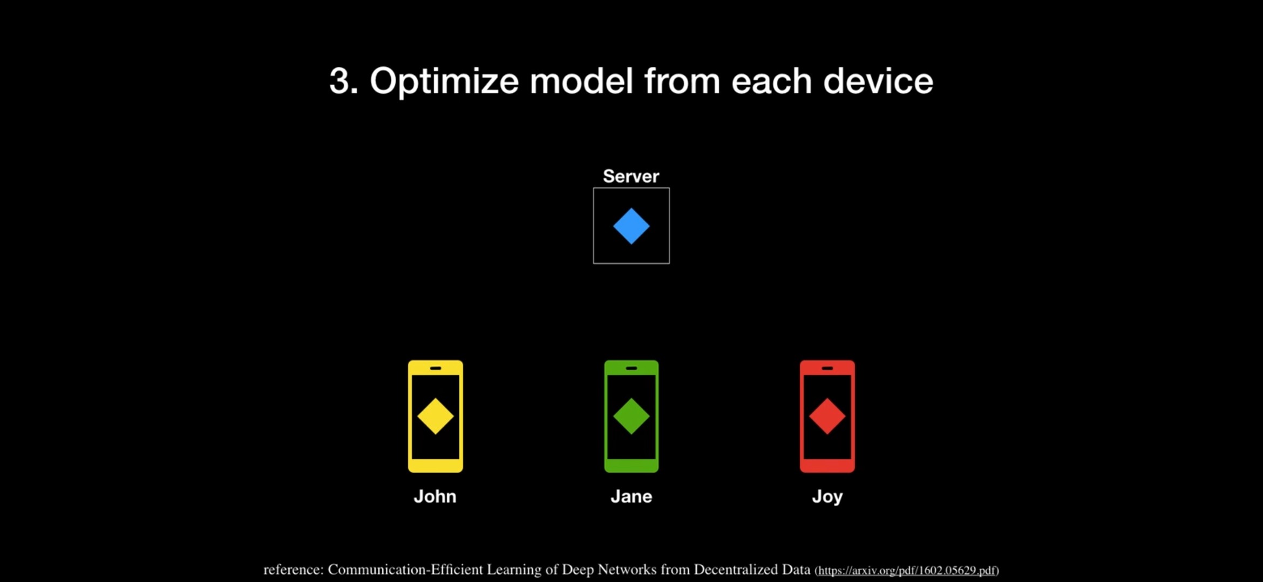
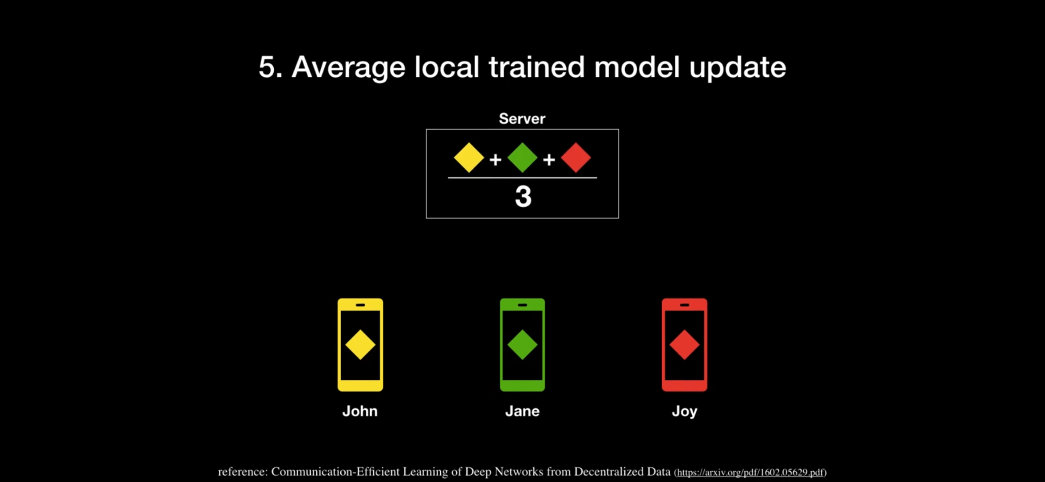
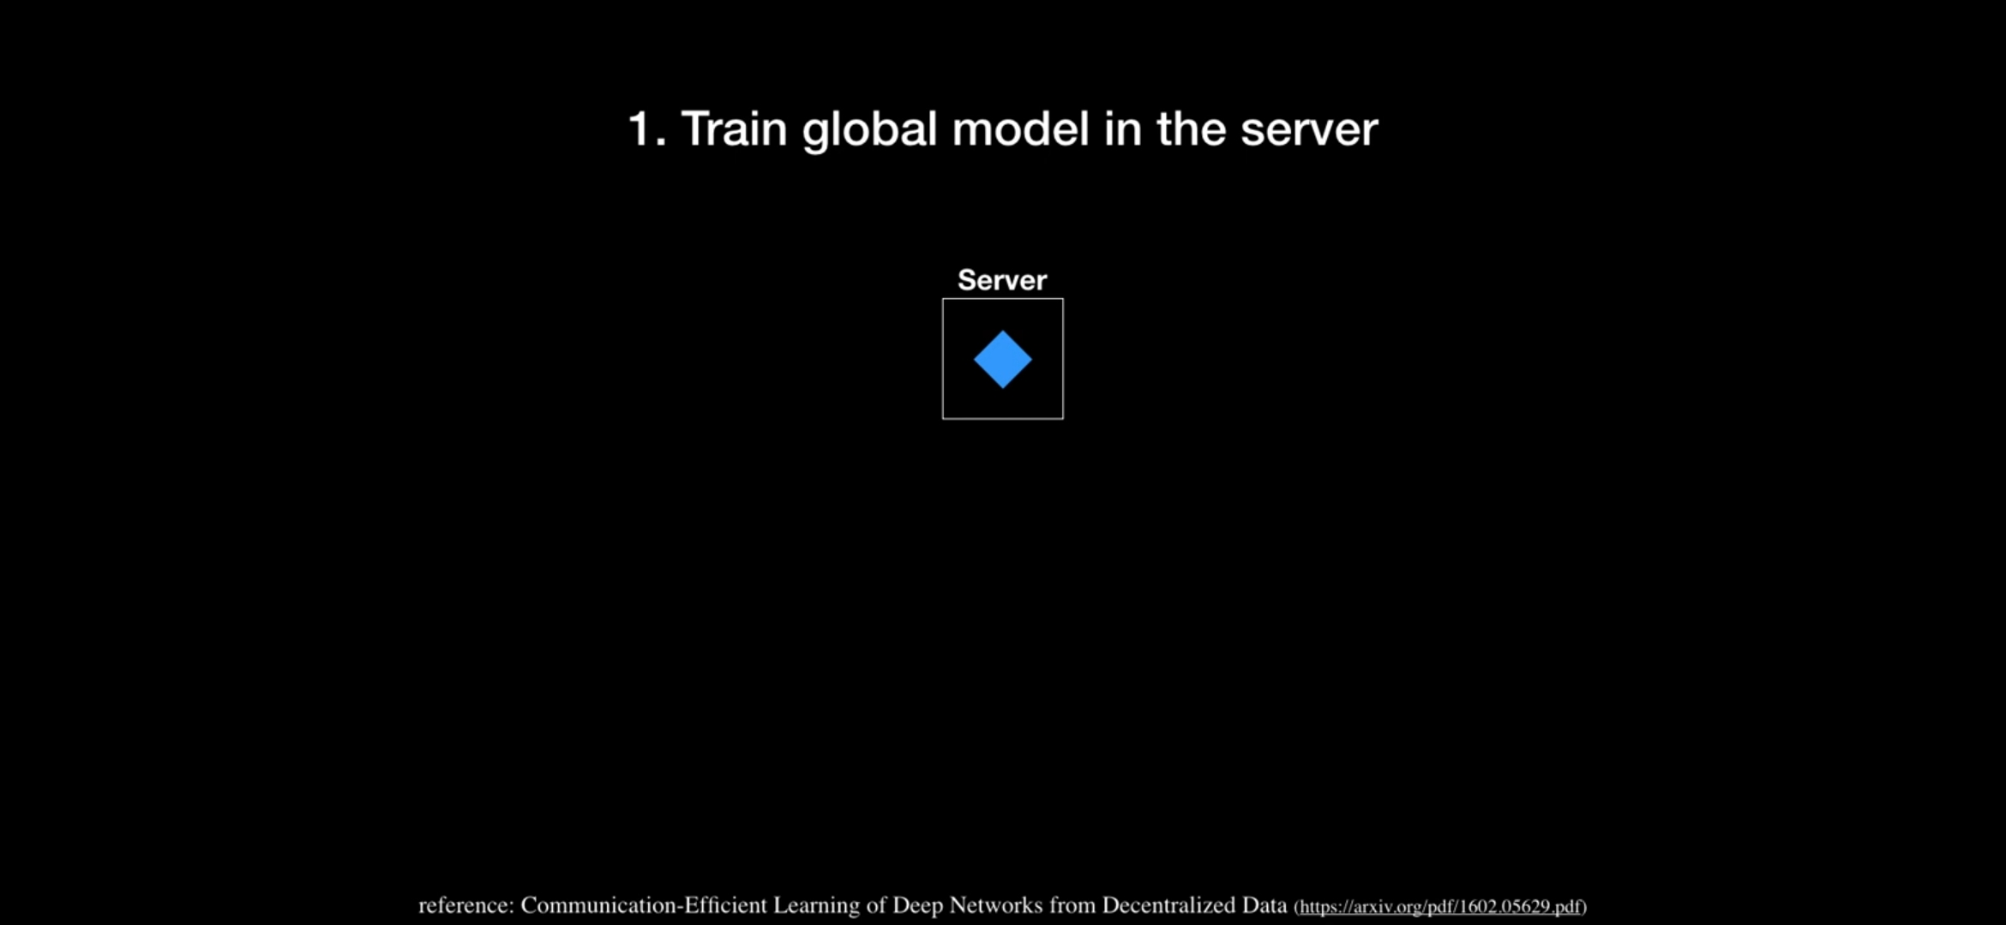
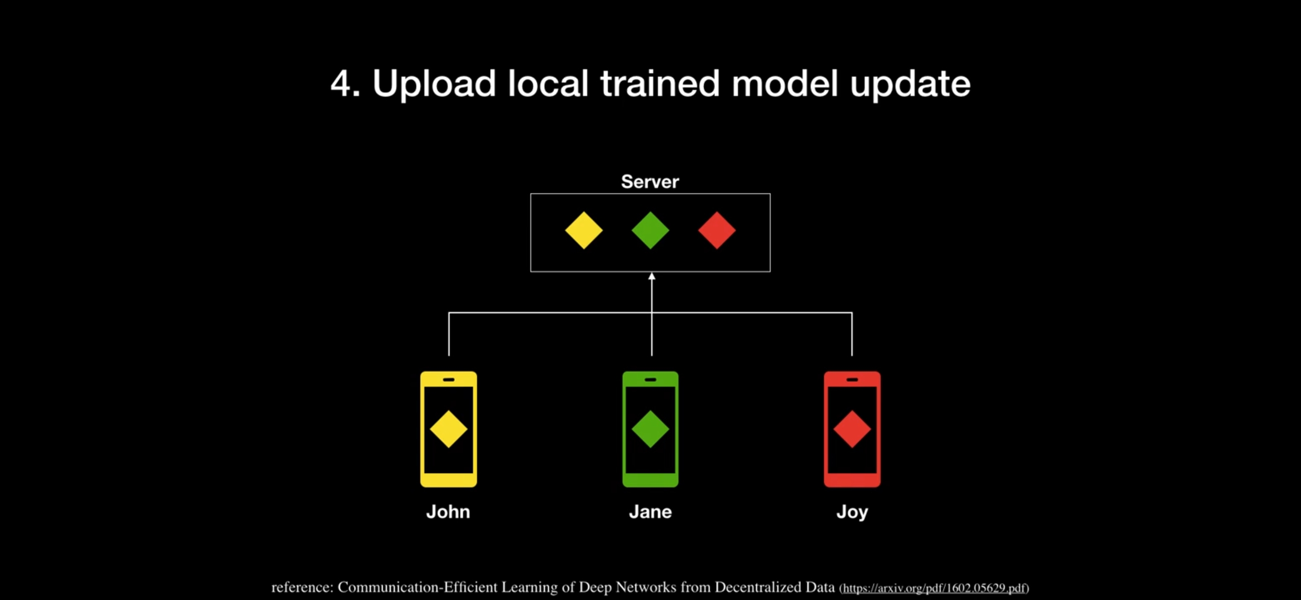
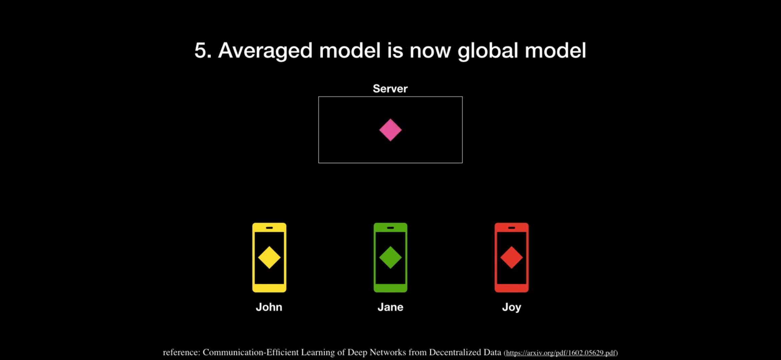
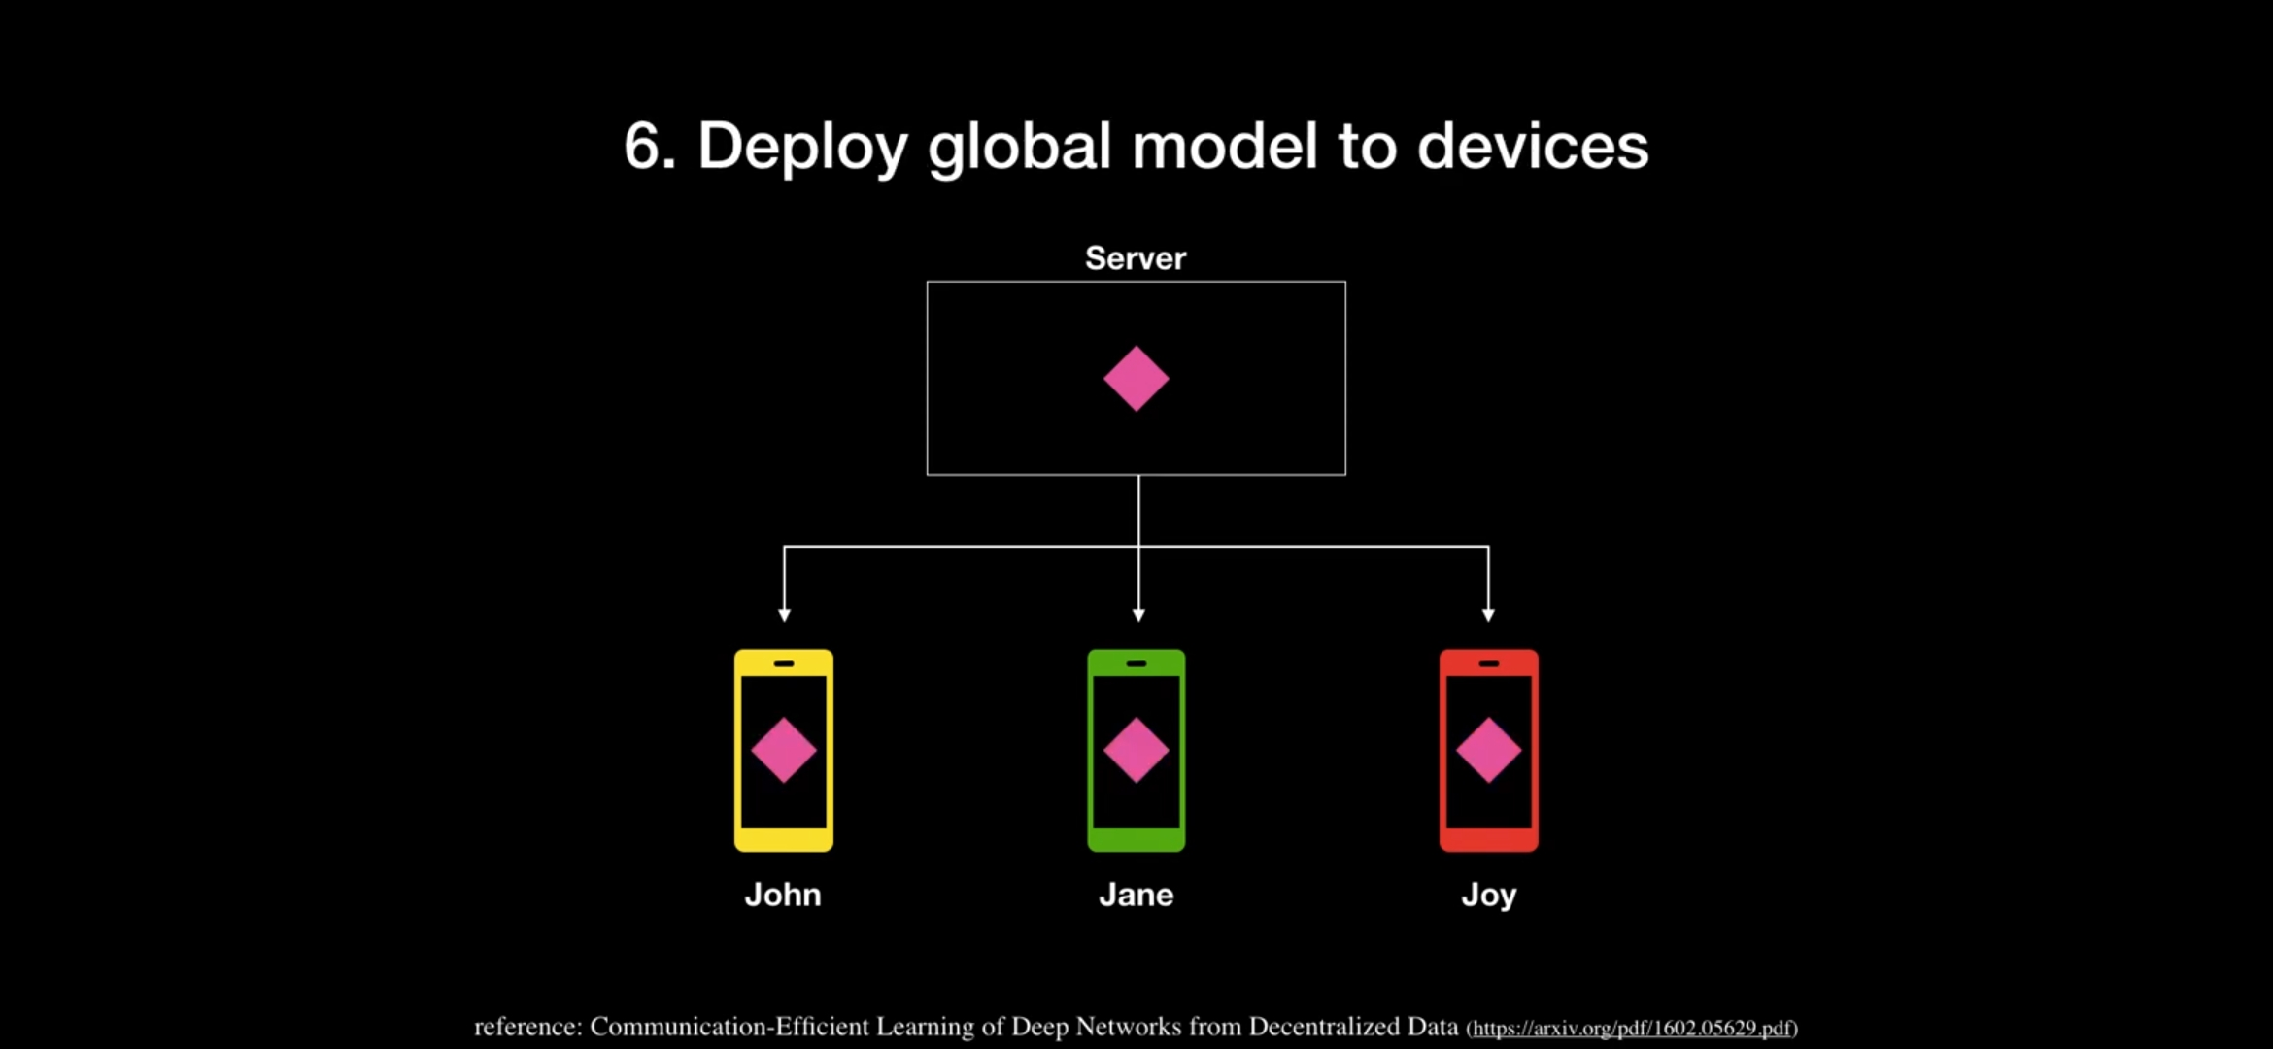
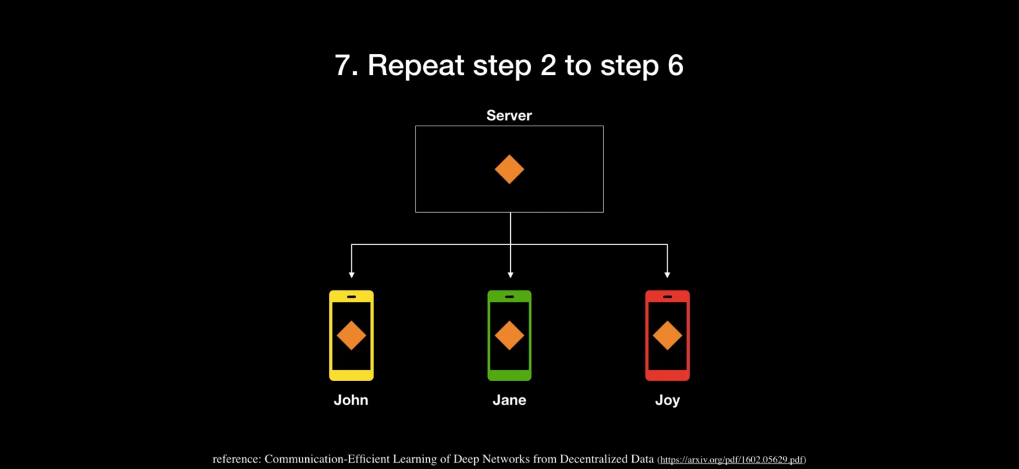
Future Scopes:
Federated learning can be applied
Multi-language BERT Model

Slide 9


